Slide 1


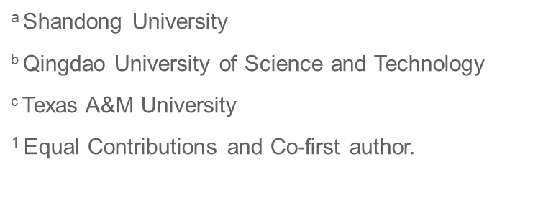
Toward precise curve offsetting constrained to parametric surfaces
Jin Zhao^{a,1} , Pengfei Wang^{a,1} , Shuangmin Chen^{b} , Jiong Guoª , Shiqing Xinª, Changhe Tu ª, Wenping Wang^{c}
Notes:
Good morning everyone. I'm Jin Zhao from Shandong University. Today I'm honored to present our recent work entitled "Intrinsic Offset Curves on Parametric Surfaces via Intrinsic Triangulation."

Slide 2
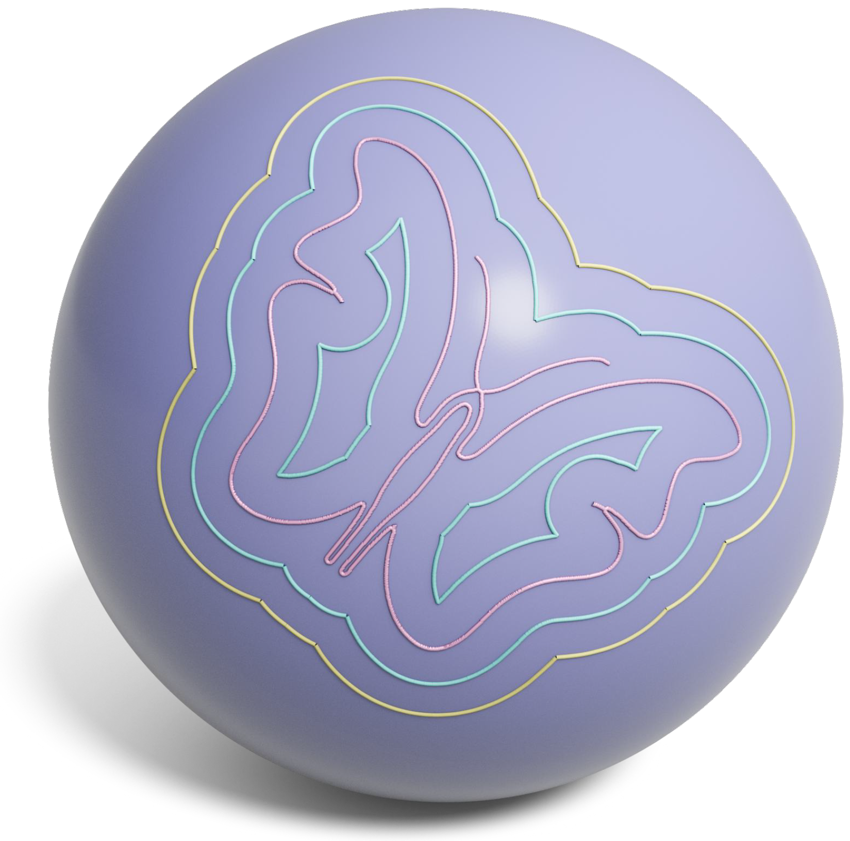
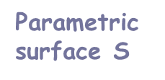
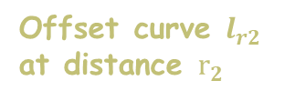
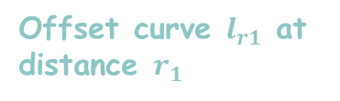

Curve Offsetting on Parametric Surfaces
Parametric surface S
Offset curve $l_{r1}$ at distance $r_{1}$
Source curve $l$
Offset curve $l_{r2}$ at distance $r_{2}$
Objective: Create parallel curves at constant geodesic distance from source curve on parametric surfaces
Notes:
Curve offsetting is a fundamental operation in geometric modeling and CAD. Given a source curve on a parametric surface, our goal is to construct another curve that remains exactly r units away from it along the surface, rather than in 3D Euclidean space.
In other words, we aim to generate a parallel curve that keeps a constant geodesic distance from the original curve at every point.

Slide 3

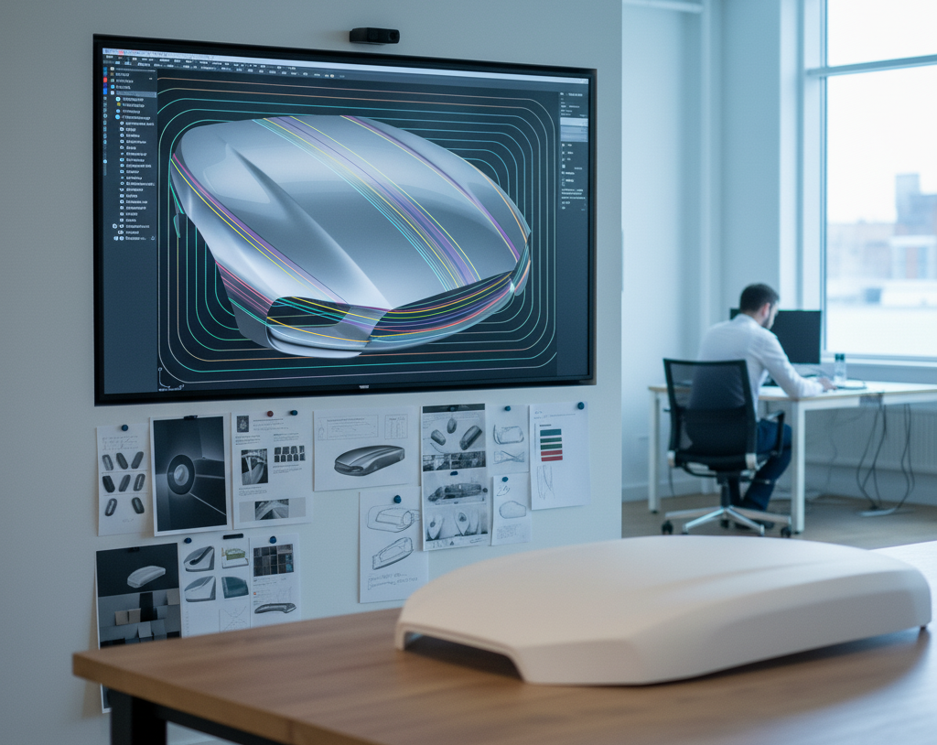
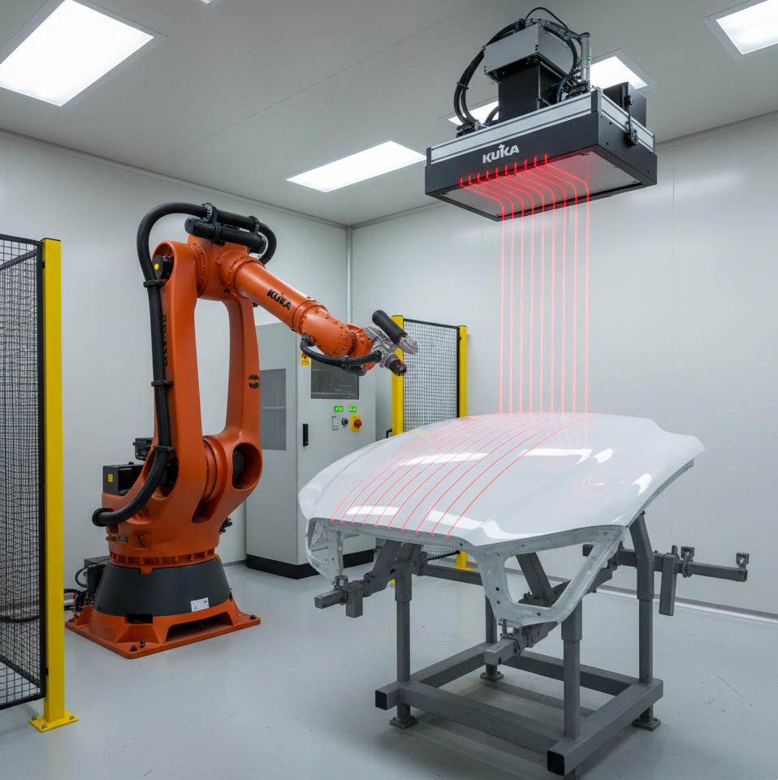
Why Curve Offsetting Matters?
Curve offsetting creates parallel curves at constant geodesic distance - essential for CAD/CAM
CNC Toolpath
Precise tool movenment in multi-axis machining
Surface Blending
Smooth surface transitions for complex geometry
Coverage Planning
Optimized area coverage for coating/inspection
Notes:
Why does curve offsetting matter? Offset curves are essential in many CAD/CAM applications.
First, in multi-axis CNC machining, we use offset curves to generate precise parallel toolpaths, ensuring uniform material removal on complex surfaces.
Second, in surface design and blending, offset curves help maintain smooth transitions between adjacent surface patches, which is critical for shapes like automotive body panels.
Third, for coverage planning in robotic coating or inspection, offset paths ensure complete surface coverage — without gaps or excessive overlaps.
So, offset curves are not just geometric constructs — they are key enablers in real industrial workflows.

Slide 4
Existing Approaches
Analytical Methods
Numerical Methods
Discrete Methods
Solve differential equations for geodesic curves
Theoretically elegant and precise
Runge-Kutta integration schemes
Iterative approximation of geodesics
Convert parametric surface to mesh
Apply mesh-based offset algorithms
Fast but loses parametric precision
Notes:
Existing approaches to surface curve offsetting fall into three categories.
Analytical methods aim to solve geodesic equations directly.They are theoretically elegant and can be very accurate.
Numerical methods use integration schemes such as Runge–Kutta to approximate geodesic distance.They are more general.
And discrete methods convert the parametric surface into a mesh and then apply polygonal offsetting techniques.
These approaches are fast,but they lose parametric precision and may introduce artifacts during discretization.

Slide 5
Limitations of Existing Methods
❌ Analytical
❌ Numerical
❌ Discrete
- Limited to specific surface types
- Closed-form solutions rarely exist
- Computationally impractical
- Expensive geodesic distance queries
- Unstable self-intersection handling
- Integration errors accumulate
- Mesh conversion loses precision
- Discretization introduces artifacts
- Cannot preserve surface accuracy
💡 A critical gap remains: No existing method achieves both high accuracy and computational efficiency without surface discretization
Notes:
Despite many efforts, existing approaches still have serious limitations.
For analytical methods, closed-form solutions rarely exist for general parametric surfaces.They often become computationally impractical.
For numerical methods, each geodesic distance query requires iterative computation on the surface,and even small numerical errors can accumulate into noticeable inaccuracies.Handling self-intersections also remains unstable.
For discrete methods, converting the parametric surface into a mesh inevitably introduces approximation errors and may lose important geometric features.
Therefore, a critical gap remains: there is still no method that achieves both high accuracy and high efficiency, while preserving the exact parametric representation of the surface.

Slide 6
Key Challenges
⚠️ Challenge 1：Geodesic Computation
⚠️ Challenge 2：Self-Intersection Handling
Requires iterative numerical integration along surface paths
Each distance query involves solving complex differential equations
No closed-form solutions exist for general parametric surfaces
Accuracy-efficiency trade-off is unavoidable in traditional approaches
Topology becomes highly complex and unpredictable as offset distance increases
Existing trimming methods are numerically unstable near tangent points
Small perturbations in input can cause dramatic topology changes
Requires expensive Boolean operations in 3D space for resolution
Notes:
Before designing a better method, we must understand the key challenges.
Challenge 1: Geodesic computation. Computing geodesic distances on general parametric surfaces requires iterative integration along the surface. There are no closed-form solutions, and each query is computationally expensive. This leads to an inevitable trade-off between accuracy and efficiency.
Challenge 2: Self-intersection handling. As the offset distance increases, the topology of the offset curve becomes highly unpredictable. Small perturbations in the input may cause cusps or self-intersections, and resolving them often requires costly Boolean operations in 3D space.
These two challenges fundamentally limit the robustness and scalability of existing offsetting techniques.
So the difficulties come from two fronts:expensive geometry and unpredictable topology.And both are tough.

Slide 7
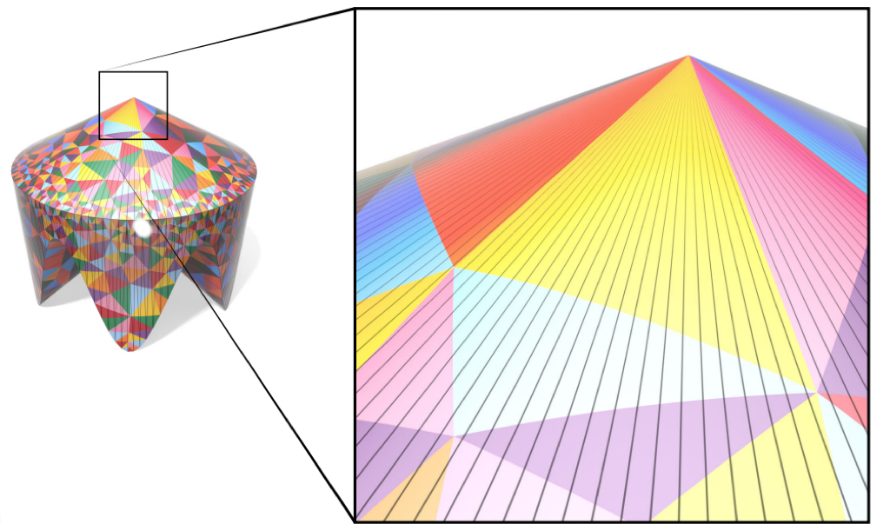
The Intrinsic Property
Geodesic are independent of spatial embedding
In parameter space - geodesics depend only on the intrinsic metric, NOT on 3D embedding
Why this works?
- Geodesic computation is an intrinsic property
- Independent of how surface is embedded in 3D
- Preserves parametric surface precision
Key Advantage
Intrinsic triangulation
Avoid expensive 3D geometric operations entirely
Notes:
A key observation is that geodesics are intrinsic. They depend only on the surface’s internal metric,not on how the surface is embedded in 3D space.
This means that instead of performing expensive geometric operations in 3D,we can work directly in the 2D parameter domain,while still preserving the true geodesic distances on the original surface.
By shifting the computation into the intrinsic space,we avoid the complexity of 3D geometry and retain the full precision of the parametric representation.
This intrinsic formulation becomes the foundation of our approach.
Based on this intrinsic formulation, the next question is:how do we maintain geometric features and avoid self-intersections during offsetting?

Slide 8
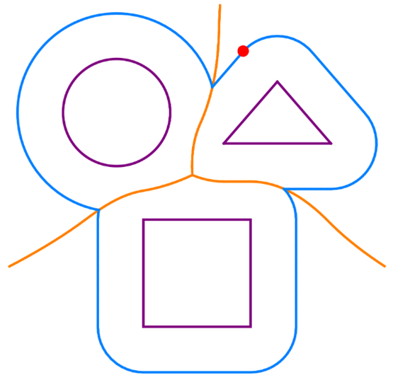
How to Maintain Feature Precision?
Voronoi-guided localized computation
Key Observation: The offset of each primitive is CONFINED to its corresponding Voronoi cell
Practical Implications
- Independent extraction per segment
- Self-intersections handled by boundaries
- Embarrassingly parallel computation
Key Advantage
Localized processing preserves geometric features while avoiding costly global operations
Notes:
The second challenge is handling self-intersections while preserving geometric features, such as cusps. Traditional methods follow a two-step pipeline : first, they generate the raw offset curve through geodesic displacement, and then they try to trim away the intersections afterward.
However, this strategy is numerically unstable, especially in high-curvature regions.
Our approach leverages a key theoretical insight: the offset of each curve primitive is strictly confined within its own Voronoi cell — this is proved as Theorem 2 in our paper. This insight enables a clean divide-and-conquer strategy:we discretize the input curve,build the Voronoi diagram in the parameter domain,and extract offsets independently inside each cell. As a result: self-intersections are naturally avoided,no unstable trimming is needed,computation is localized and parallelizable,and geometric features — including cusps — are faithfully preserved.

Slide 9

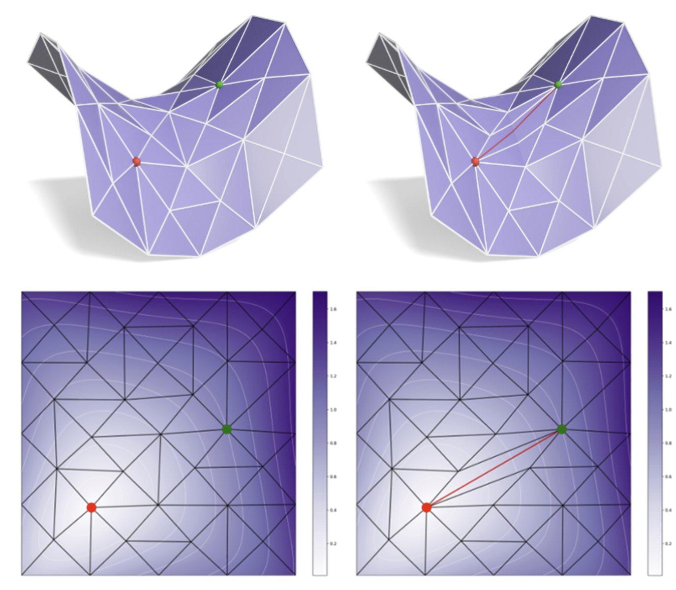
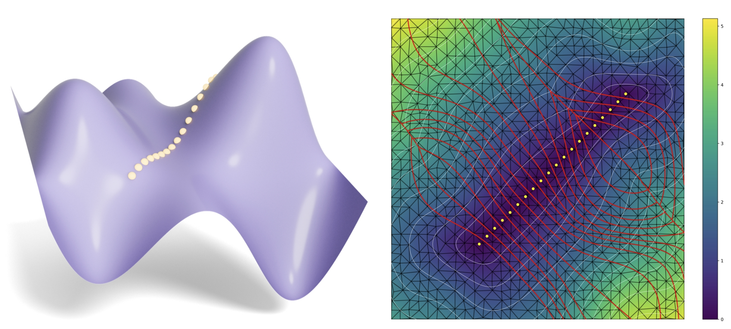
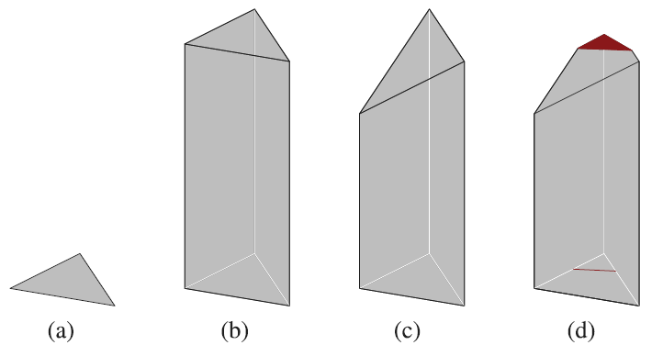
Our Method Overview
Constructing Intrinsic Triangulation
Result
Voronoi Diagram Computation
Offset Curve Extraction
Notes:
Now let me give you an overview of our complete pipeline, which has three main stages.
First, we construct an intrinsic Delaunay triangulation in the parameter domain that respects the surface’s metric.
Second, we compute the Voronoi diagram of the discretized source curve using this intrinsic metric, producing the localized decomposition discussed earlier.
Third, we perform offset curve extraction: inside each Voronoi cell we extract offsets via a plane-cutting operation on a height field representation, which preserves features such as cusps.
The result is accurate offset curves directly on parametric surfaces.I will now walk through each stage in detail.

Slide 10
Constructing Intrinsic Triangulation
Build Delaunay triangulation in parameter space
The edge flipping method : Iteratively flip edges to approximate geodesic distances
No expensive 3D geometric queries needed
3D parametric
surface
2D parametric domain
Initial
Result
Flip
Notes:
The first stage is constructing the intrinsic triangulation.
We work entirely in the 2D parameter domain of the surface. In this domain, we build an intrinsic Delaunay triangulation that encodes the surface metric.
Here's the key insight: existing methods can compute geodesic distances on triangle meshes through edge flipping operations. We extend this idea to parametric surfaces by performing intrinsic triangle flipping directly in the parameter space. Through these flipping operations, we can accurately compute geodesic distances on the parametric surface—all in 2D, without any expensive 3D queries.
This gives us a solid and efficient foundation for the remaining stages.

Slide 11
Voronoi Diagram Computation
Discretize curve into m segments
Edge flips approximate geodesic Voronoi on intrinsic mesh
Result:
Each cell = independent processing region
→ Natural parallelization
3D parametric surface
2D parametric domain
Notes:
The second stage is Voronoi diagram computation.
We discretize the source curve into small segments in the 2D parameter domain,and compute their geodesic Voronoi diagram on the intrinsic triangulation.
Each Voronoi cell represents the region of influence of one segment —meaning the offset of that segment will stay strictly inside its own cell.
This gives us a localized decomposition of the surface around the curve.The cells are independent, so the processing becomesrobust, numerically stable, and parallelizable by design.
This step is essential for preventing self-intersections and for preserving local geometric features.
Now with the intrinsic triangulation and the Voronoi cells in place,we are ready to extract the offset curve itself.

Slide 12
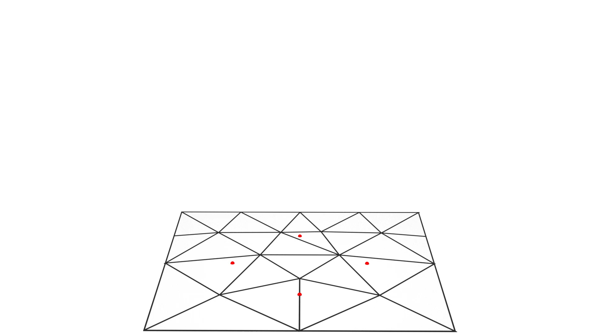
Offset Curve Extraction
Self-intersections handled naturally by cell boundaries
Within each Voronoi cell:
Intersect plane at distance r with triangles
Extract curve segments
Merge into complete offset curve
Notes:
The final stage is offset curve extraction.
On the left, you can see a dynamic visualization of our incremental cutting process.
Inside each Voronoi cell, we construct a height field that represents the geodesic distance in the 2D parameter domain,and we extract the offset curve by intersecting this field with a plane at distance r.(播动画)
As the plane moves, the offset segment gradually forms within each cell —with no self-intersections, because the cell boundaries naturally prevent them.
This localized operation preserves sharp features such as cusps,and the final offset curve is obtained by merging all extracted segments together.
Now let's look at how our results compare against the state-of-the-art.

Slide 13
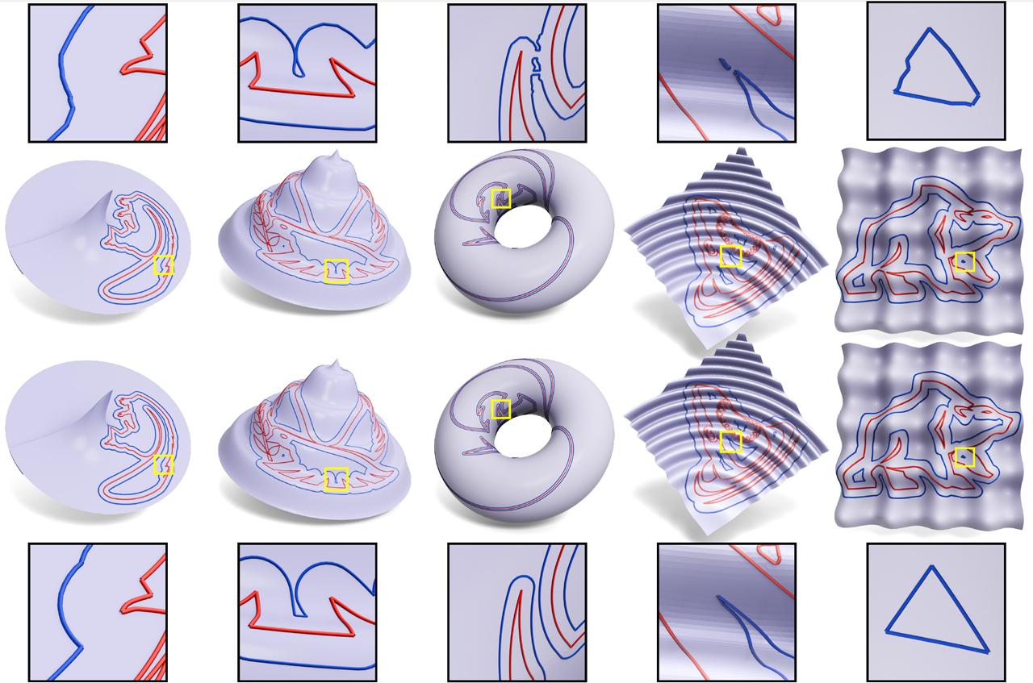
Result: Visual Comparison
Missing cusps
Feature loss
Xin et al.
Cusps preserved
Feature accurate
Ours
Notes:
Here we show a visual comparison with the state-of-the-art method by Xin et al. (指向左图) Their result loses some geometric features —for example, the cusps are missing or smoothed out.(指向右图) In contrast, our method faithfully preserves these sharp features,while still producing a clean and accurate offset curve.
This demonstrates that our localized, intrinsic formulation handles complex geometry much more robustly.
Let’s also look at the quantitative results.

Slide 14
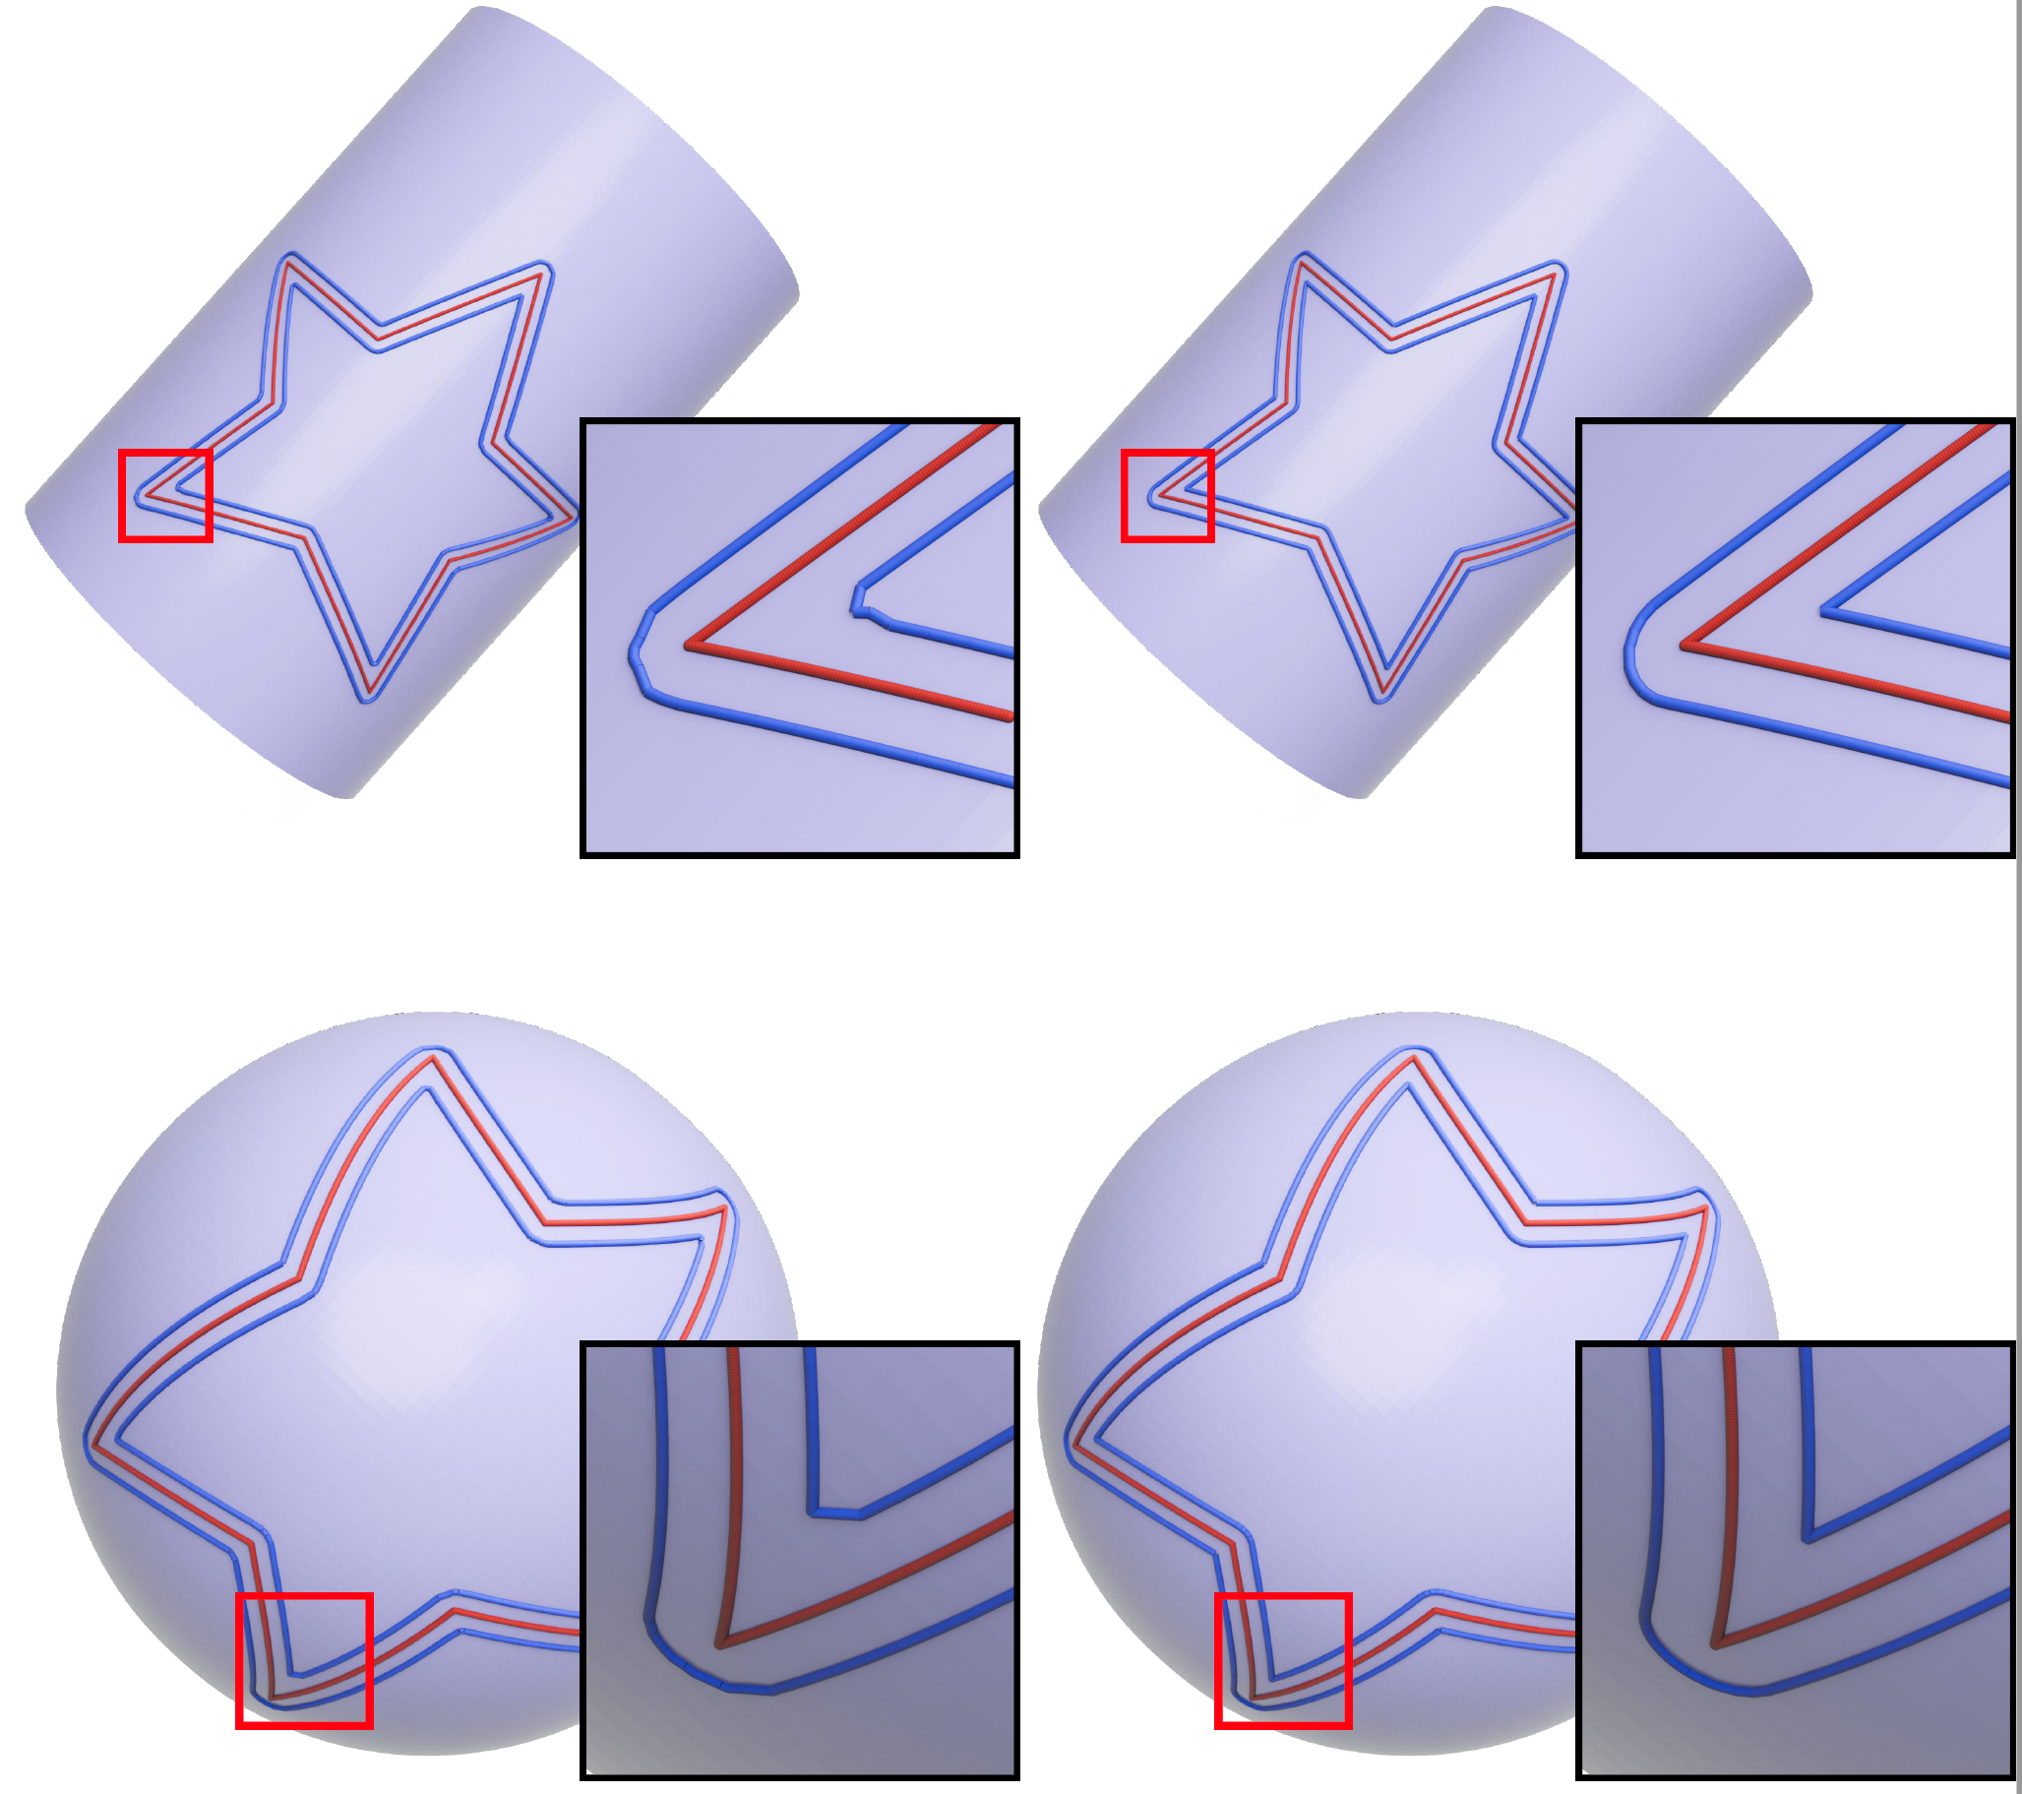
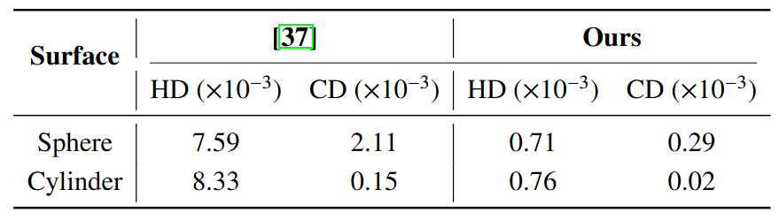
Quantitative Comparison
Table: Quantitative comparison of offset curve accuracy
Xin et al.
Ours
• Lower Hausdoff distance
• Lower Chamfer distance
• Better feature preservation
Xin et al.
Ours
Notes:
Here is the quantitative comparison. We evaluate the offset accuracy using Hausdoff distance and Chamfer distance between the computed result and ground truth.
As shown here,our method consistently achieves lower distance errors than Xin et al.,meaning we preserve the true geodesic offset more accurately.
In addition, we maintain important geometric features,which further reduces shape distortion in the final result.
So both visually and numerically,our method demonstrates significantly better performance.
Now let’s examine the performance efficiency.

Slide 15
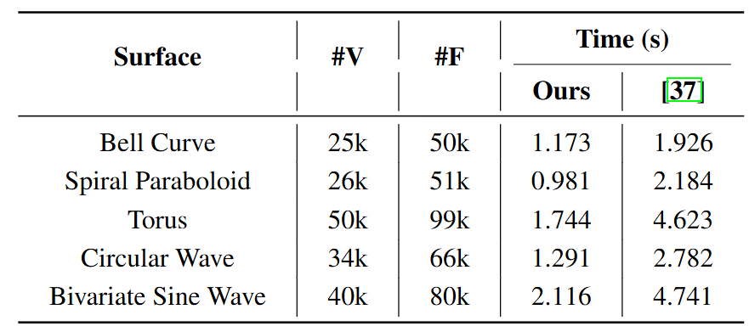
Runtime Comparison
Table: Runtime performance comparison on different models
Xin et al.
Ours
1.5-2× faster than state-of-the-art.
Consistent speedup across all test cases
Notes:
In terms of computational efficiency, we benchmark both methods on five complex models with 25k–50k vertices.
Our method consistently achieves 1.5–2× faster performance than the state-of-the-art. This improvement comes from our intrinsic geodesic computation in parameter space, which avoids the heavy cost of exact geodesic queries on the mesh.
Moreover, the speedup remains stable across different surface geometries, demonstrating strong robustness and scalability.

Slide 16
Scalability Analysis
Runtime vs. No. of Discrete Points
Runtime vs. Offset Distance
Linear scalability with both mesh complexity and offset distance - suitable for large-scale applications
Notes:
We also evaluate the scalability of our approach.
As the model complexity increases — meaning more surface detail and more curve segments —our runtime grows nearly linearly, and the accuracy remains high.
This is because all computations are localized within Voronoi cells, allowing independent processing and efficient parallelization.
Therefore, our method scales well to large and complex CAD geometries, making it practical for real industrial scenarios.
Finally, let me show some additional results and demonstrations.

Slide 17
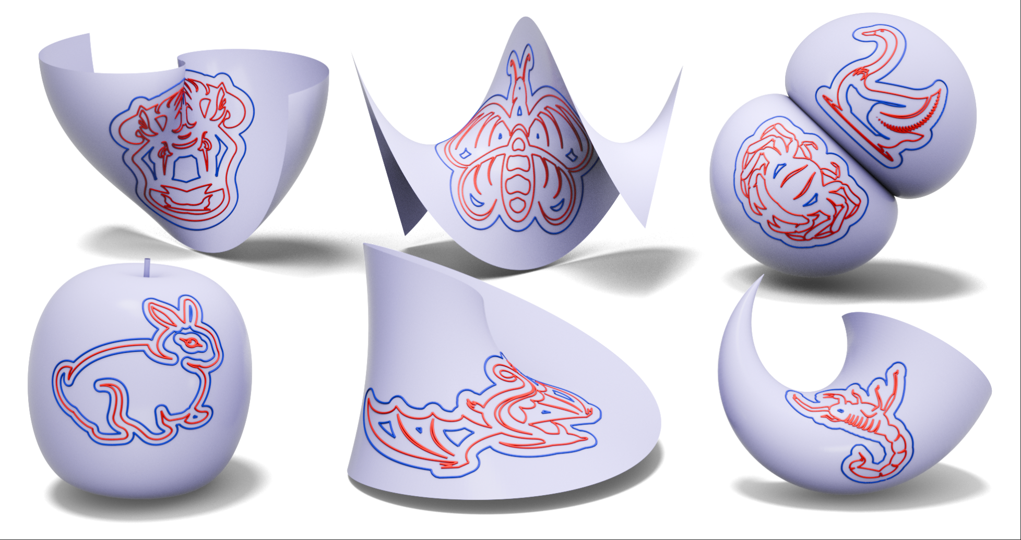
Result Gallery
Robust performance across diverse geometric features
Notes:
This gallery shows a range of models and offset distances to illustrate the method’s versatility.
Across these examples — from smooth surfaces to highly undulating ones — our method consistently produces accurate offset curves. Note how cusps and sharp features appear where expected, and how small-scale details are preserved even at larger offset distances.
These visual results complement our quantitative and runtime comparisons and demonstrate that the approach works robustly across diverse geometries.

Slide 18
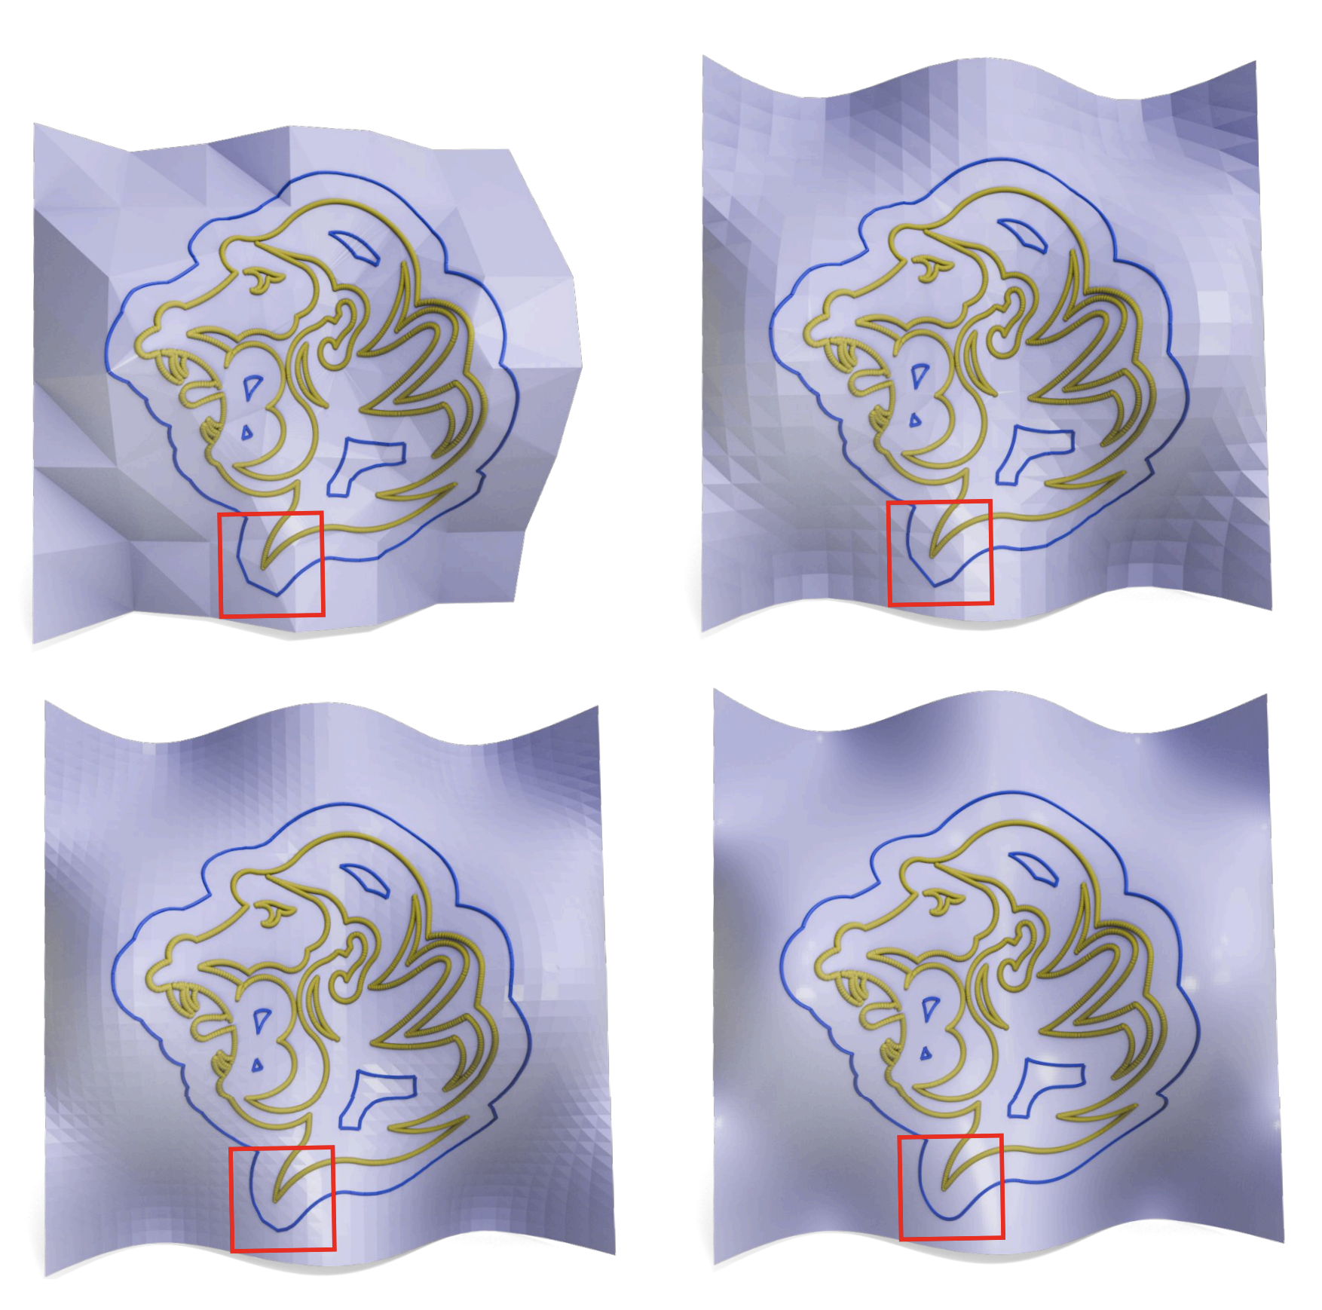
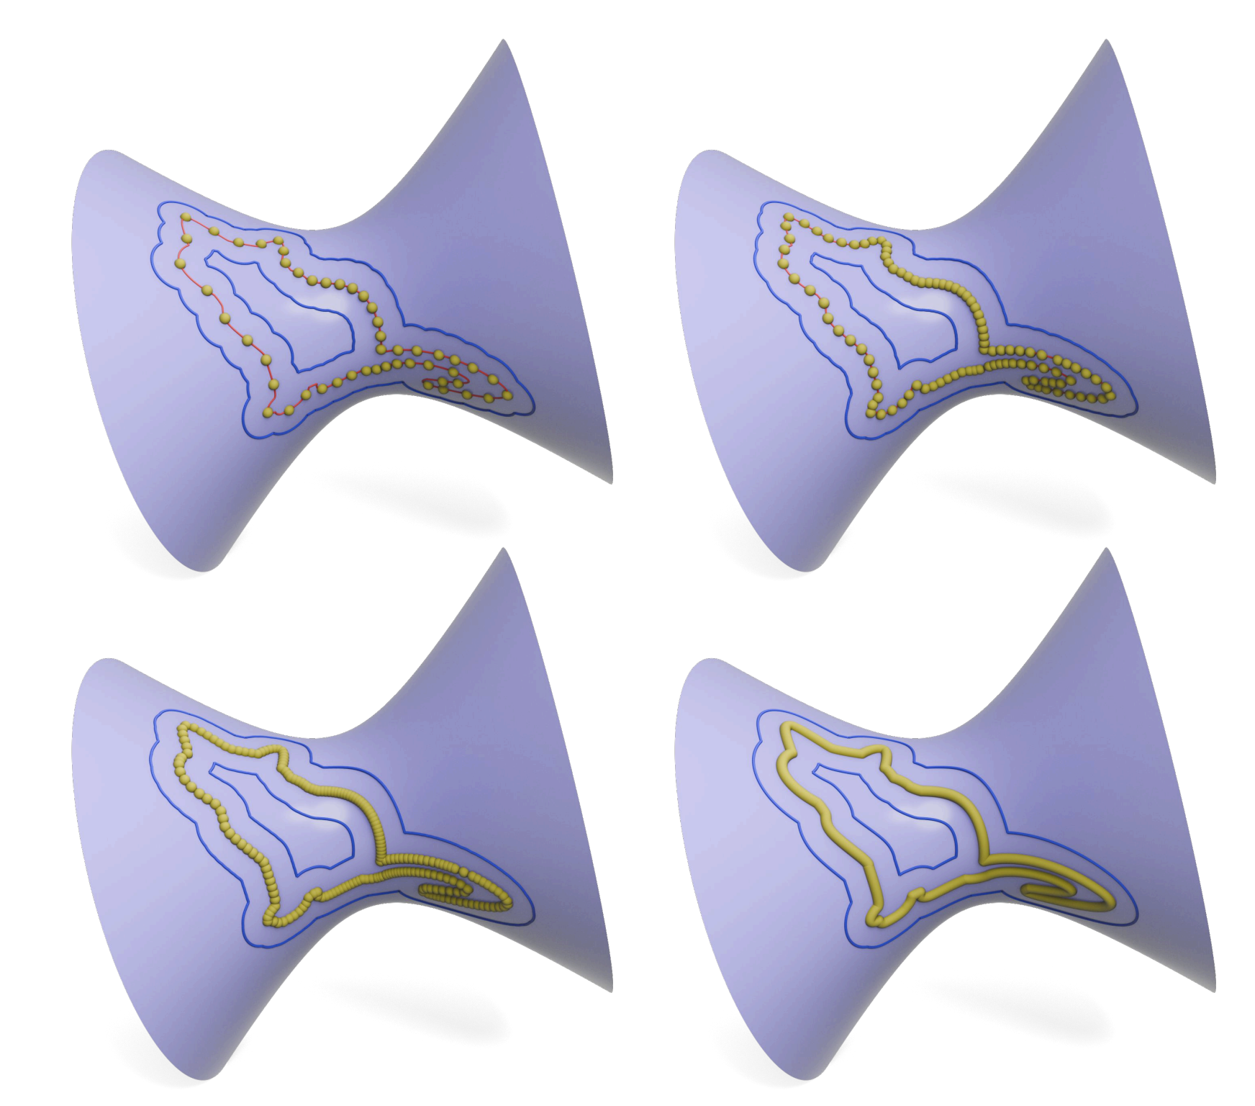
Ablation Study
72 triangles
800 triangles
50 sampling points
100 sampling points
200 sampling points
2000 sampling points
3200 triangles
8000 triangles
Source Curve Discretization
Triangle Mesh Density
Notes:
To better understand the contribution of each component in our method, we conduct an ablation study.
On the left, we test different sampling densities of the source curve. As you can see, denser sampling leads to more accurate results. With only 50 sampling points, the offset curve shows visible segmentation artifacts. As we increase the sampling density to 200 and beyond, the results become visually satisfactory.
On the right, we vary the resolution of the intrinsic triangulation. While higher triangle density generally improves accuracy, the key observation is that our method preserves geometric features consistently across all resolution levels. Even with a coarse triangulation, the structural characteristics are maintained.
This confirms that both components play critical roles: adequate curve sampling ensures smooth offsets, while our Voronoi-based approach guarantees feature preservation regardless of mesh resolution.

Slide 19
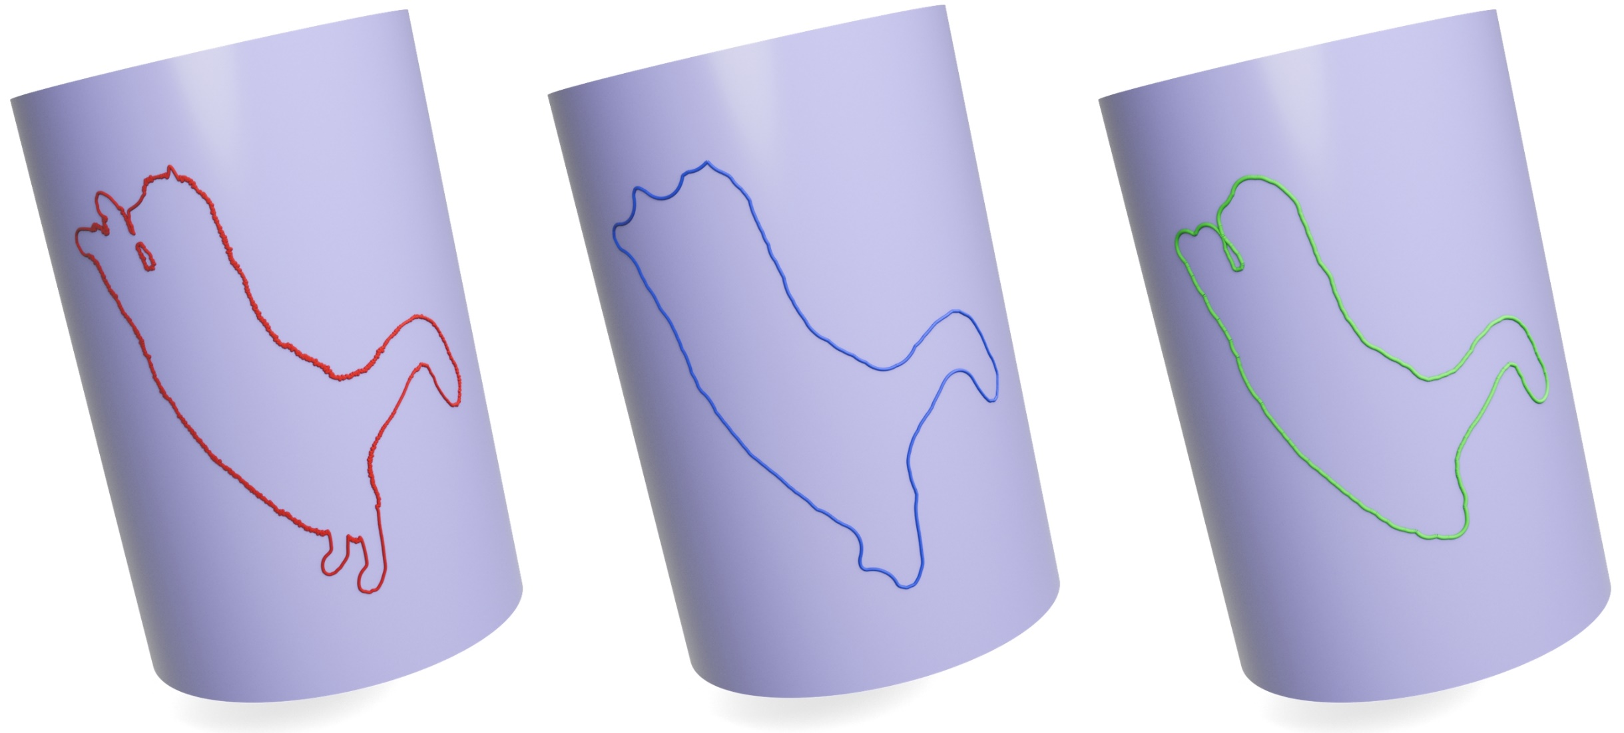
Morphological Operations
Input
Closing
Opening
Opening (erosion → dilation): Removes small features
Closing (dilation → erosion): Fills small holes
Our method enables robust morphological operations on parametric surfaces
Notes:
Our method also enables morphological operations on parametric surfaces,which are widely used in image processing.
Here we demonstrate two basic operators: closing and opening.
Closing, shown in blue, performs dilation followed by erosion.It fills small gaps or holes while preserving the overall curve structure.
Opening, shown in green, does the opposite — erosion followed by dilation — removing small protrusions and producing a smoother curve.
These operations are useful for smoothing, noise removal, and feature simplification in CAD workflows. And since our framework supports both inward and outward offsets consistently,these morphological operations are natural and easy to implement.

Slide 20
Limitations and Future Directions
Current Limitation:
Limited to explicit parametric surfaces
Performance depends on mesh quality
Requires closed parametric domains
Future Direction :
Extend to surfaces with boundaries
Adaptive triangulation for high-curvature regions
GPU acceleration for real-time performance
Notes:
Despite these promising results, our method has some limitations that we plan to address in future work.
Currently, our approach is limited to explicit parametric surfaces and requires closed parametric domains. Additionally, the performance depends on the quality of the initial triangulation in the parameter space.
Looking ahead, we have identified three key directions for improvement. First, we plan to extend our method to handle surfaces with boundaries, which would significantly broaden its applicability. Second, we aim to implement adaptive triangulation that can automatically refine high-curvature regions while maintaining efficiency in smoother areas. Finally, we're exploring GPU acceleration to achieve real-time performance for interactive applications.
These enhancements would make our method even more practical for industrial CAD and manufacturing workflows.

Slide 21
Conclusion
Summary
A Novel Intrinsic Approach to Offset Curves on Parametric Surfaces
Intrinsic
Triangulation
Voronoi
Decomposition
Offset
Extraction
Higher Accuracy
Faster Speed
Better Feature Preservation
Key Results
Notes:
To conclude, we presented a novel intrinsic approach for computing offset curves on parametric surfaces.
Our method consists of three key components. First, we construct an intrinsic triangulation in the parameter space equipped with the surface-induced metric. Second, we compute the Voronoi decomposition of the discretized curve segments. Third, we extract offset curves locally within each Voronoi cell, which naturally handles self-intersections without special treatment.
Compared to existing methods, our approach achieves three significant advantages: higher accuracy with over ten times improvement in error metrics, faster computational speed with 1.5 to 2 times speedup, and better feature preservation including proper cusp generation.
This work demonstrates that by exploiting the intrinsic geometry of parametric surfaces, we can achieve both efficiency and precision for offset curve computation, making it practical for real-world CAD and manufacturing applications.
Thank you for your attention.

Slide 22



